Slide 1

True Analytics &
Base-Band Visualization
A Return to Tukey’s Exploratory Data Analytics and Bloom’s Taxonomy
Overwhelmed with the analytics of all that data?
Why YOU must reset the lost art of true analytics
and lead back to leveraging data in its basic form…
By James P. LaRue
AAS Instrument Electronics
BA Mathematics and BA in Education
MS Mathematics
PhD Applied Science and Engineering
Signal Surveyor and Exploratory Data Analyst by Profession
James P. LaRue, www.DataPlasticity.com 2016

Slide 2


Outline
Introducing YOUR Eco-System
A hierarchical sales format (with Bloom intro)
Where does Tukeys EDA enter Bloom’s Taxonomy ?
It may surprise you…
A formal business and technology problem statement
A sonobuoy big data example (it is equivalent to streaming IP)
What do we mean by base-band visualization?
We’re not talking pie charts, but practical and meaningful pixel arrays
Finding pattern within plasticity of 1s and 0s
Revisit the business/tech problem, plus a Model/Simulation example
The advantage to actually increasing the number of data points
A table based problem in Excel
Returning to YOUR Eco-System
Edureka: Pause for educational advertisement
The Charter Global strategic data analytics reset program
True analytics and the round table Eco-system

Slide 3

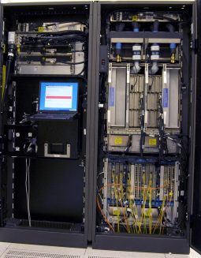

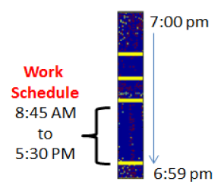


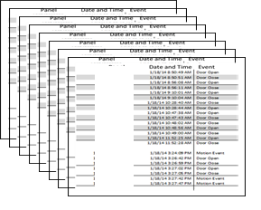

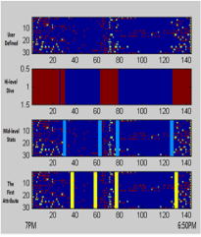


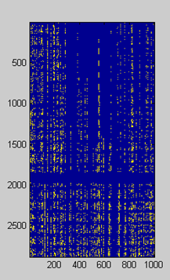
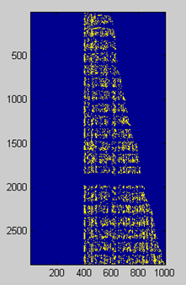
A proposed BD/BI question
The BI/BD answer
+
ECO-derivatives
Systems Architect & Security
Data Source
Acquisitions and ETL
The Eco-system of Data
requires a base-set of
thought provoking visualizations
to initiate round-table discussions
to drive cross-table observations
to empower team consensus
to draw-out winning derivatives
Customer Activity
Segment Extract and Model
Data QA-Post ETL/Pre Model

Slide 4
Hierarchical Sales Format & Bloom’s Taxonomy of 1956
Assess Current State
Playbook Development
Technology Forensics
Foundation-Orientation
Cursory Evaluation of Blueprint
Knowledge
Comprehension
Application
Analysis
Synthesis
Evaluation
Develop Roadmap
Infrastructure Support
Vendor Stack Selection
Big Data Architecture + Tools
BD/BI User Trials
Data Aggregation
Analytics Demo
Implementation Analytics Team
Develop
Augment
Administer
Actualize Launch & Yield
Future Aspirations
Partnering and
Planning
Retained Agency of Record

Slide 5
Bloom’s Taxonomy & the Cognitive Domain
+
Tukey’s Exploratory Data Analysis (EDA)
Knowledge: assembling facts and making definitions about the data
Comprehension: translate, interpret, extrapolate, organize the data
Application: solve problems using knowledge + comprehension of the data using old models
Analysis: break data into the elements, examine the pieces, generalize the data
◆  Fact: John Tukey introduced the term ‘bit’, the contraction of Binary Digit
Synthesis: partition data elements into segments and apply old models or form new models
Evaluation: present and defend what you think you KNOW about the data based on model
Pie chart visualizations are for conveying knowledge, comprehension and evaluation of data
Base-band visualization is for analyzing the raw-form elements of data in pixel form
Formulas are for application and reference in evaluation
Creativity lies in synthesis and applies pressure to evaluation
http://en.wikipedia.org/wiki/Bloom%27s_taxonomy/ http://en.wikipedia.org/wiki/John_Tukey

Slide 6

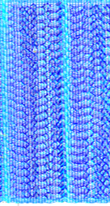
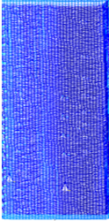

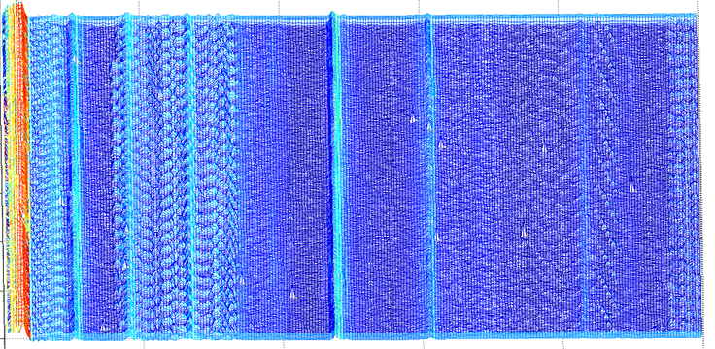

A Formal Business & Technology Solution
Business Outcome: Oil company to address environmentalist concerns of
disturbing whale habitat and feeding, breeding, and resting. X amount of
Dollars available to look for solution.
Premise 1: Underwater blasting for Seismic surveys affects habitat.
Premise 2: Whales, and other cetaceans, naturally change habitats.
Premise 3: Shipping traffic affects habitat domain.
Business Side
Hypothesis to premise 1: Abrupt changes in pressure due to blasting damages
the ears of the whale.
Hypothesis to premise 3: Shipping noise affects whales ability to communicate.
Problem Domain: How does changes in pressure link correlation between shipping traffic, seismic blasting, and whale movements?
4
2
1
3
5
Develop Facets: Use exploitation
techniques to uncover hidden
attributes and then group.
(K-means, higher moments, image
Processing/computer vision)
Technology Side
Data Source: Sonobuoy recording
12000 pts/sec x 24 hrs = 1 Gpts/1 day
Notes:
This slide shows the beginning to a solution. An oil company worked with the US Government and a group of educational institutions in what was called the LADC experiment. The project involved recording ambient noise in the Gulf of Mexico in the context of seismic surveying (blasting underwater) and its effect on ocean life.
The bottom rectangular blue plot represents a left to right 24 hour block of sound pressure recorded on a sonobuoy. Is this Big Data? Yes!. The buoy recorded 12,000 pressure points per second, for 24 hours. Each point required two bytes of memory to store the pressure and meta-data. That equates, roughly, to 1 Gb of stored memory. Now in fact, there were actually three buoys recording at that rate, but for 30 days. Certainly, it would be difficult to listen to the whole sound recording. To look at the raw data meant looking at the blue rectangle. Rather than blindly reaching into the data set to start the analysis that would answer business directives, a series of specialized signal processing compression techniques were used to engineer a better visualization. Those results are shown in the rectangle above the blue one. The new rectangle appears with a series of contrasting vertical strips and blocks of colors. These strips and blocks were then partitioned into five groups. The five groups were presented in a pie chart to the BD/BI team. Now the horizontal line segments that separate the business side from the technology side represents an artificial, but somewhat real, division between the two groups. However, when the pie chart was handed over, there were relevant accompanying tag lines such as: stormy weather, ships passing, calm weather, pre-deployment, and seismic exploring. It began dialogue between business and technology; which partition(s) of the Giga-Bite pie offer the best ROI.

Slide 7
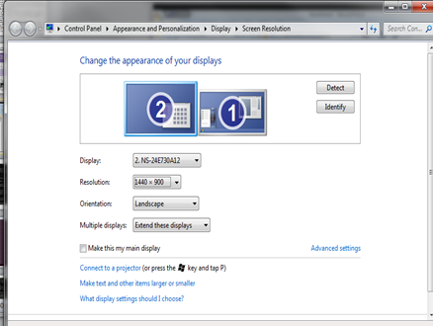
Base-Band Visualization Part One:
1440 x 900 pixels is a lot of pixels, so let’s use them…

Slide 8

Base-Band Visualization Part Two:
Color the elements…
Colorbar
ranges
from
0 to 1
1
1
1
1
0
1
1
Given the
code word
elements:
1111011

Slide 9
A little faster now…
1 1 0 0 0
1 1 1 1 0
1 0 0 0 1
1 0 0 1 0
0 0 0 0 1
1 1 0 0 1
1 1 0 0 0
Five
Seven element
Code words
to
7x5 pixel matrix

Slide 10
A 7x50 pixel matrix
11000011111001001101101010010111101100011010111000
11110100111101101000101110101100010111001111000100
10001011111001100010100101001100010010010001011011
10010011001001000000010011111011110100000001101110
00001010101010100101001101111001011000111110100010
11001101101110110000110101000011011110111101000100
11000001101101110001111010110100000111101000011001

Slide 11
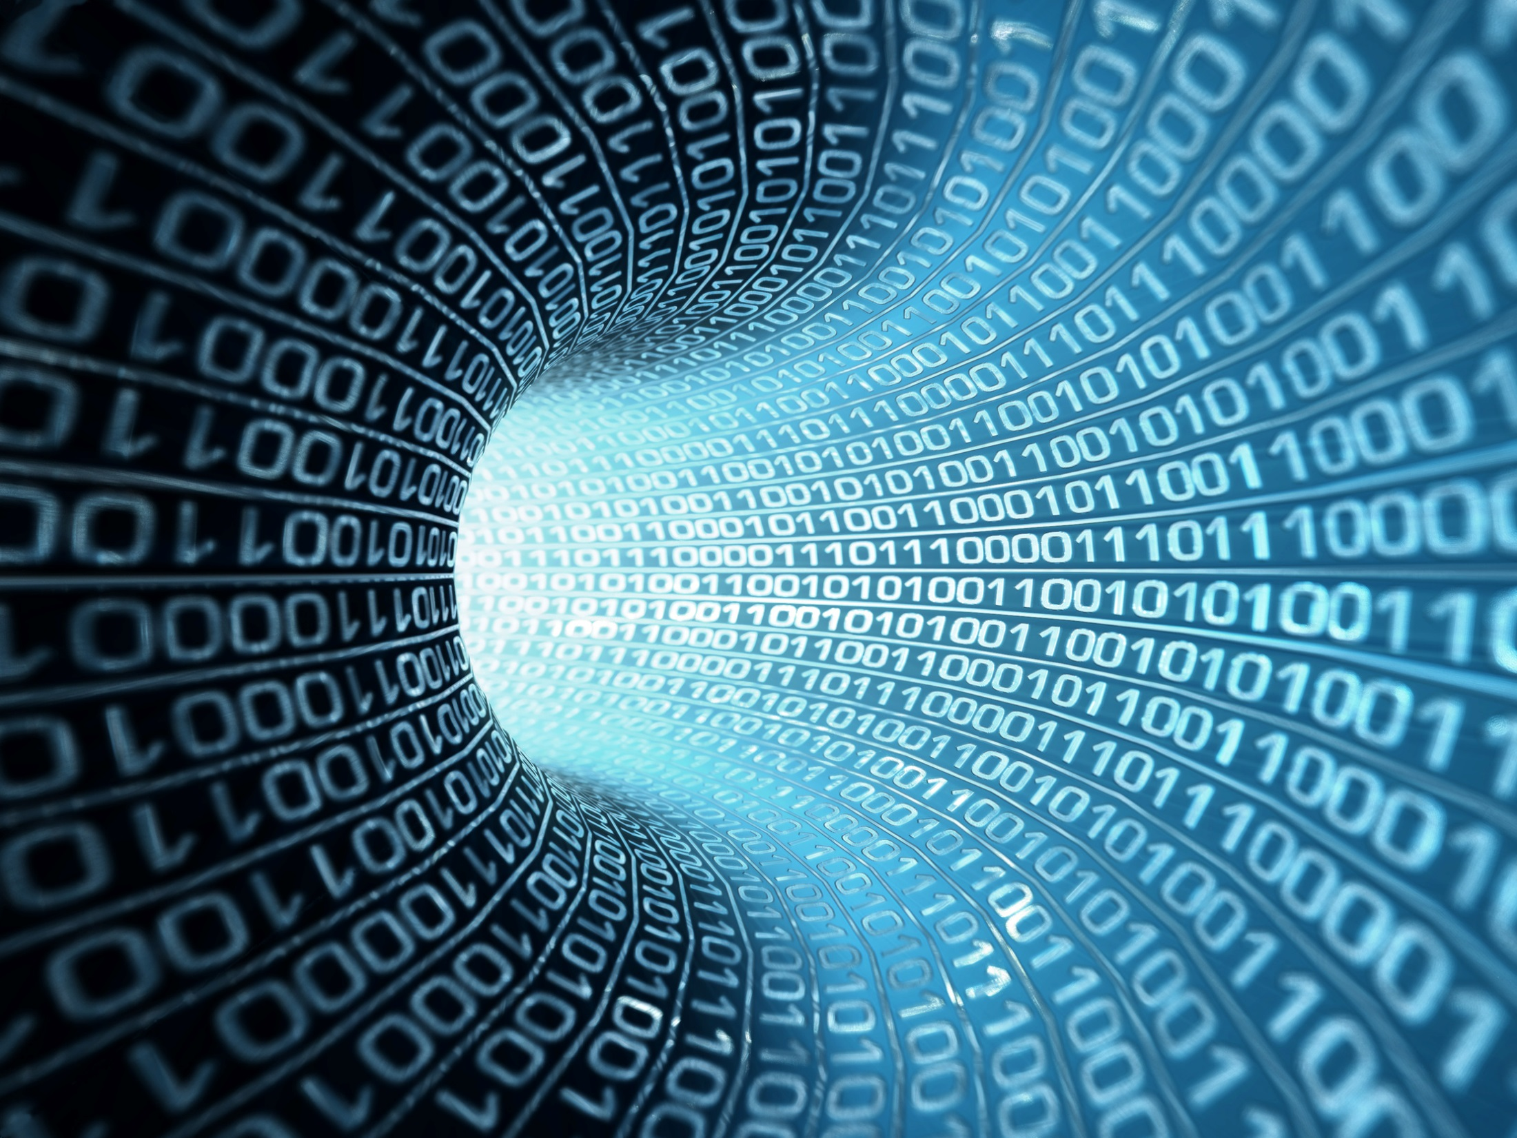
Finding Patterns in Patterns of 1s & 0s

Slide 12
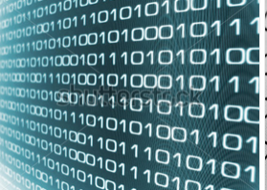
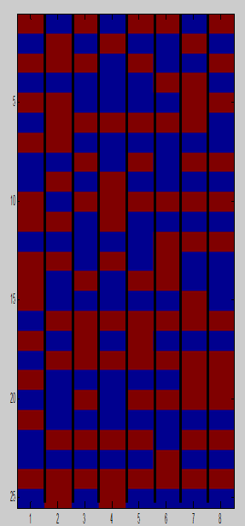
Exercise in Pattern Digging
4
5
1
2
1 0 1 0 1 0 1 0 0 1 1 0 1 1 1 0 1 0 1 0 1 0 0 1 0
0 1 1 0 1 1 1 0 1 0 1 0 1 0 0 1 0 1 0 0 0 1 0 1 1
1 0 1 0 0 1 0 1 0 1 0 0 0 1 0 1 1 1 0 1 0 1 0 1 0
0 1 0 0 0 1 0 0 1 1 1 0 1 0 0 1 0 1 0 0 0 1 0 1 1
1 0 1 0 0 1 0 1 0 1 0 0 0 1 0 1 1 1 0 1 0 1 0 1 0
1 0 0 1 0 1 0 0 0 1 0 1 1 1 0 1 0 1 0 1 0 0 1 1 0
0 1 0 1 1 1 0 1 0 1 0 1 0 0 1 1 0 1 1 1 0 1 0 1 0
1 0 1 0 1 0 0 1 0 1 0 1 0 0 0 1 0 1 1 1 0 1 0 1 0
3

Slide 13
A 1000x1000 pixel matrix
1000 columns of 1000 random numbers ranging -5 to +5
1,000,000 unique colors being displayed.
Imbedded here

Slide 14
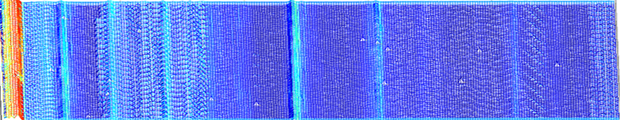
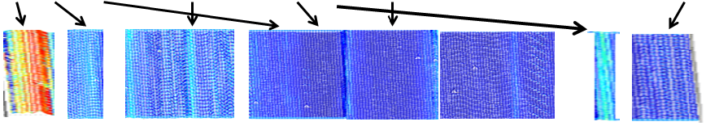
Return to the Sonobuoy Example with Tukey’s EDA
We took the 1,000,000,000 acoustic sonobuoy points, transformed a little, and formed a data pool matrix of 1000 x 8000 elements. At a high level, the information appears uniform.
However, from the blue data pool of elements, signal processing uncovers several underlying structures. (buoy carrier, oil explorations, ships, storms, calm seas).
These structures form the new elements. Thus from one data source, we form several more data pools. This segmentation is presented to the Eco-system, to initiate round-table discussions, to drive cross-table observations, to empower team consensus.

Slide 15
Why look at two simple plots when you can look at 300 simultaneously ?
(3-30 MHz by increments of .1)
MATLAB
Notes:
Image plot of path loss for sea state 3.
This is another view of the two previous slides,
The colorbar indicates path loss.
The axis show 3-30 MHz, 0 through 300 nautical miles, and 20-160 dB path loss.
We plotted two individual plots and show where they project onto the 3-D plot to give better clarity to the 3-D picture.
Clearly, there is a trough around 5 MHz.
This report corresponds to CCIR report 322 which includes noise from atmoshperic, man-made, and thermal sources.
Receiver Threshold is bounded by (VTRPE path loss + Receiver Noise + Eb/No)
The red merely relates to the upper limits to the path loss

Slide 16
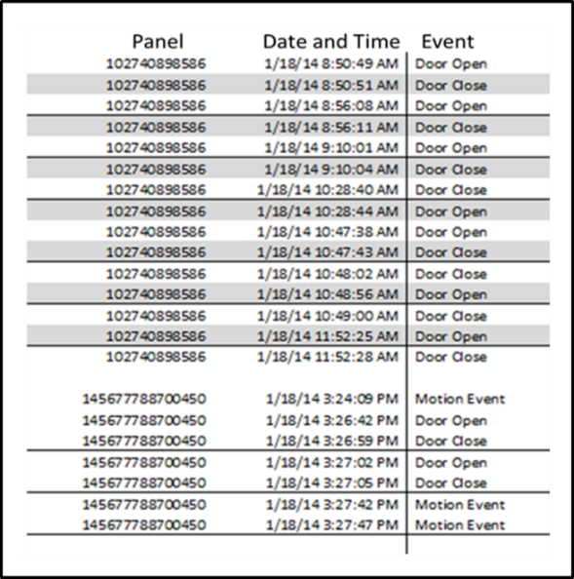
A Database Example that Moved from Row Entry to Time Domain
1000 customers were recorded for Open/Close door activity over 28 days. during the day. Activity ranged 50-750 door Open (gold)/Close (blue) total activities per customer. We expanded the table to form a uniform time scale of 100 time slots per day per home. i.e., 2800 time slots for each of the 1000 customers.
Took spreadsheet of ~78,000
lines of feature events
Engineered time domain to
visualize as 2800x1000 matrix
Applied a cascade of
discovery transforms
Customer
Day 1
Day 28
Presented the 2,800,000 events in discovery framework to BI team
Red box: 40% of customers did not have device installed properly
Green Box: 30% had late starts
Yellow box: Data Warehouse dropped 30 hours of (paid for) recorded data
Analytics at this fundamental level is a section of QA

Slide 17
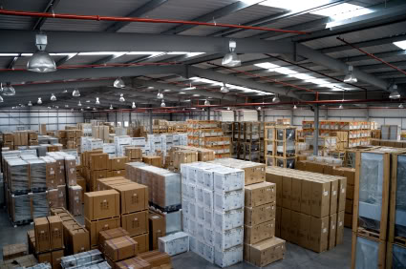


Base-Band Visualization of Analytics Invites a Roundtable Approach
2. ETL asks Data Warehouse
For activity on 1000 customers.
DW returns 78,000 table entries
1. BD task - work schedule
6. BD Solution
1-6: Eco-System Derivatives
7:00 pm
Architecture/Data Storage
DW purchase lapse
ETL
Data Source Consistency
Modeling
20% valid segment
BI
24 Hr. Home Habits
BD
Ask Techs to check sensors
Work
Schedule
8:45 AM
to
5:30 PM
Customer Activity
6:59 pm
3. Engineer a structured
visualization
4. Signal Processing to see what you have or thought you had
5. Modeling & Simulation solution with what you have

Slide 18
Edureka !!
Others that are honing in on EDA and Visualization
From the Computation Institute (University of Chicago/Argonne National Labs) and AT&T Labs
https://www.ci.uchicago.edu/blog/new-algebra-data-visualization and
https://www.ci.uchicago.edu/blog/new-computational-commons-cancer-genomic-data
An Algebraic Process for Visualization Design by Kindlmann and Scheidegger (2014), http://algebraicvis.net/assets/vis2014_talk_slides.pdf
Data Mining Challenges for Digital Libraries by founder of Open Data Group, Robert Grossman. Back in 1996 he mentions three principle purposes for Visual Analytics: anomaly checks, Tukey’s EDA, and checking model assumptions.
John W. Tukey wrote the book "Exploratory Data Analysis" in 1977
From to Data Visualization Innovation Summit, April 2015, San Jose, Elijah Meeks, Senior Data Visualization Engineer at Netflix, presented, ‘Beyond Line and Pie Charts: Practical Applications of Complex Data Viz’
https://www.codeshowse.com/ Charleston, SC May 2015, with keynote speaker Jeff Hammerbacher of Cloudera presenting his work with Big Data and predicting the process and treatment of disease.

Slide 19
Strategic Data Analytics Reset Program
True Analytics & the Roundtable Eco-System
BEFORE YOU START your investment path
(take a step back)
DEFINE THE GAME
Your Business Development Directive
(keep it purposely loose)
GET TO KNOW your BI/BD/ETL/Mod/Dev team
(collective or stove-piped)
ESTABLISH ACCESS TO your Big Data Repository
(costly and ad-hoc deck of cards)
Set the odds to success
Base-band visualization (show what’s in the deck)
Now, call in your players and…
STAND BACK AND LEAD

Slide 20
Lagniappe

Slide 21
If Neuroplasticity can be defined as the shaping process of thought, then Data Plasticity can be defined as the shaping process of enumerated thought. More pointedly, let Data Plasticity refer to the physical appearance of the reshaped number as it goes through the processing stages of exploratory data analysis (EDA). EDA is a termed first coined by John Tukey in the 1960's, who among many of his accomplishments co-invented the Fast Fourier Transform with Cooley and came up with the word 'bit' from 'binary digit'. However, what Tukey lacked was the ability to visually examine the affected plasticity of his EDA process which focused on transformation and segmentation prior to classification. Thus what this website offers pixel-level description of the so-called 'Big Data' framework using Tukey's EDA. Just as a Kaleidoscope reshapes light, we will treat the computer monitor as the facilitator of a deeper understanding of the data transformation by reshaping it into a matrix of colored pixels. One of the first dramatic visualizations using a computer monitor was carried out by Mandelbrot back in 1980 as he formed a two dimensional display of black and white dots portraying the concept of fractals by Julia and Fatou dating back to 1908. It is only in the last 10-15 years that computer graphics has enabled an even deeper look into a data's plasticity throughout EDA.

Slide 22

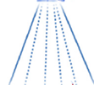



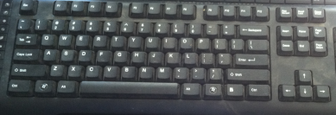
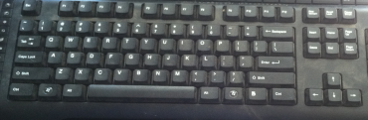
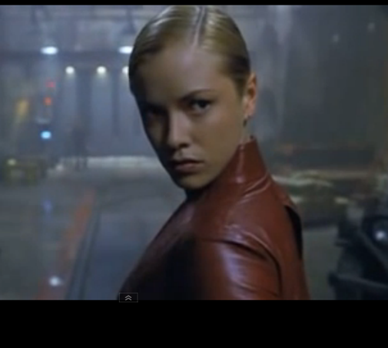
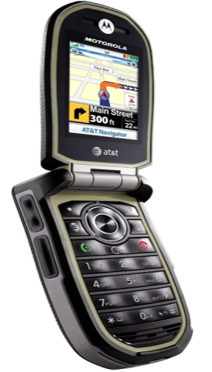
Kristanna Loken in Terminator 3 – Rise of the Machines
Early on, she dials up a Data Warehouse for information on her target John Connor.
The next thing you hear is their speaking ‘fax’ over the phone …,

Slide 23



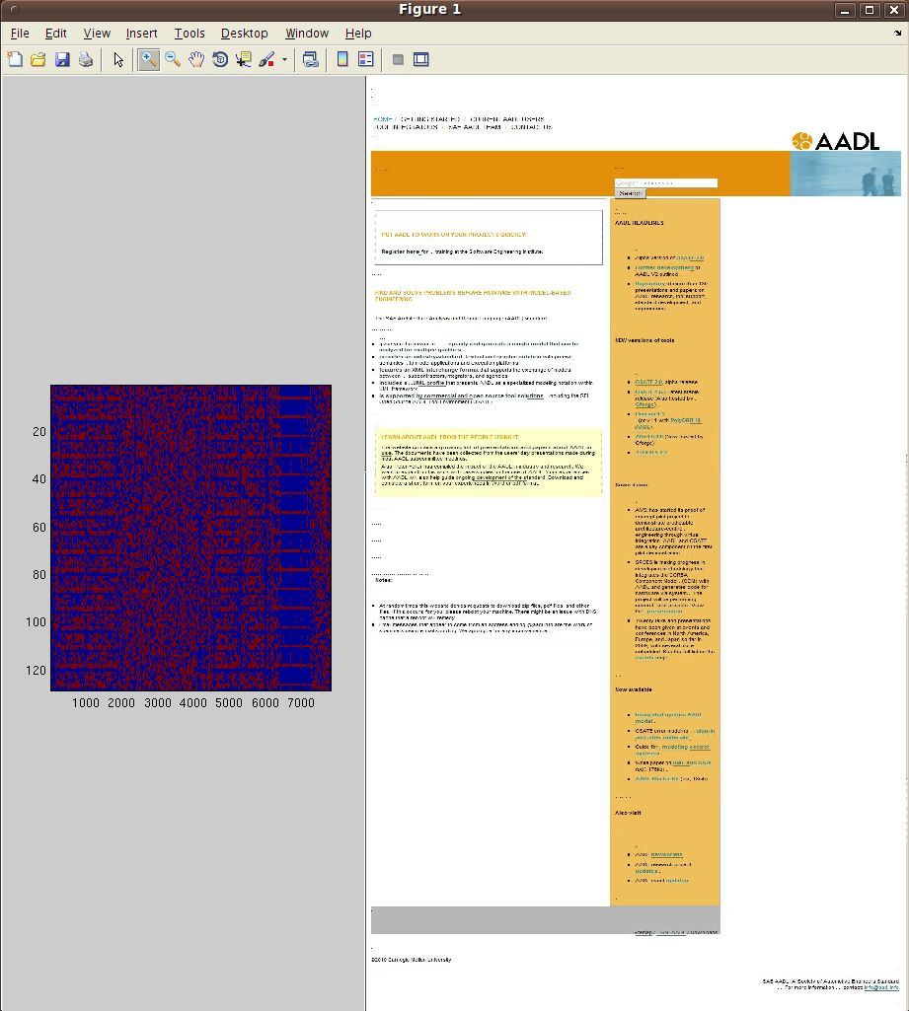


BIG DATA
Perception Center
Streaming traffic
Audio/Visual

