Slide 1

Bee1 – (1) 16,000 samples recorded at 22,000 samples/second.
(2) 3,000 points
(3) 500 points

Slide 2
Bee1 – (1) 2,000 points
(2) Cepstrum

Slide 3
Bee2 – (1) Reframe the 16,000 points at 180.
(2) Overlay of frames 11-13
(3) Overlay of frames 83-85

Slide 4
Bee2 – (1) 84,000 samples recorded at 44,100 samples/second.
(2) 10,000 points
(3) 1000 points

Slide 5
Bee2 – (1) 3,000 points
(2) Cepstrum
199 is the bending number

Slide 6
Bee2 – (1) Reframe the 80,000 points at 199.
(2) Overlay of frames 119-121
(3) Overlay of frames 241-243

Slide 7
Sheep – (1) 28,000 samples recorded at 22,000 samples/second.
(2) 10,000 points
(3) 1000 points

Slide 8
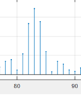
Sheep – (1) 1,000 points from 10,000 – 11,000
(2) Cepstrum on these 1,000 points (with zoom)
83 is the bending number
Zoom

Slide 9
Sheep – (1) Reframe the 28,000 points at 83.
(2) Overlay of frames 119-121
(3) Overlay of frames 241-243
Coherent on 83
Non-Coherent on 83

Slide 10
Sheep – (1) 28,000 samples recorded at 22,000 samples/second.
(2) 3,000 points (from different area)
(3) 5000 points

Slide 11
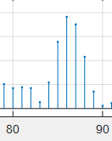
Sheep – (1) 1,000 points from 20,000 – 21,000
(2) Change in Cepstrum on these 1,000 points (with zoom)
86 is the new bending number
Zoom

Slide 12
Sheep – (1) Reframe the 28,000 points at 86.
(2) Overlay of frames 119-121
(3) Overlay of frames 241-243
Non-Coherent on 86
Coherent on 86

Slide 13
Mosquito – (1) 50,000 samples recorded at 44,100 samples/second.
(2) 5,000 points
(3) 1000 points

Slide 14
Mosquito – (1) 3,000 points from 20,000 – 23,000
(2) Cepstrum on these 3,000 points
153 is the bending number

Slide 15
Mosquito – (1) Reframe the 50,000 points at 153.
(2) Overlay of frames 11-13
(3) Overlay of frames 158-160

Slide 16
Cricket – (1) 81,000 samples recorded at 11,025 samples/second.
(2) 3,000 points
(3) 300 points
Three structures to analyze: (1) Train of all pulses, (2) Set of Three pulses, (3) Single Pulse
All pulses
at 11025 Hz
Three pulses
at 11025 Hz
At 5000 Hz
Single Pulse
At 1000 Hz
At 2500 Hz

Slide 17
Starting with single pulse
A single pulse within 170 samples
(2) The spectrum, with components at 129 Hz and 4151 Hz
(3) The cepstrum showing 8 as bending number

Slide 18
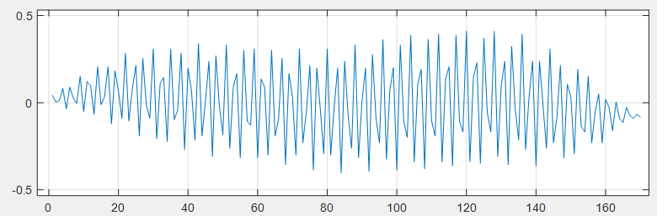
How do 4150 Hz and 8 sample separation relate?
Sampling Rate is 11,025 samples/second.
4150 Hz = 4150 cycles/second (that’s the fast
switching up and down in the pulse.
2.65 samples/cycle
That’s ~8 samples/3 cycles is the (true full) period under
this sampling condition (note: cycles are partial at 2.65)
Cycle 1
Cycle 3
Cycle 2

Slide 19
How does 129.7 come into play?
It’s the underlying modulation/envelope to 4151
Sampling Rate is 11,025 samples/second.
129.7 Hz = ~ 130 cycles/second
RED= .4*sin(65Hz).^2 == .4*(1-cos(2*65Hz))/2
GREEN= -.4*(1-cos(65Hz))/2==-.4*(1-cos(2*37.5Hz))/2
Note: There seems to be two underlying modulations

Slide 20
Next: Three pulses
A train of 3 pulses with 3000 samples
(2) The spectrum, with components at 33 Hz and 4156 Hz
(3) The cepstrum showing 492 as a new bending number

Slide 21
Guessing that the 33 Hz which ~ 65/2 is related to the underlying modulation shown in the
‘How does 129.7 come into play?’ slide. The 4156 Hz is just about the same as below.
It comes down to frequency resolution.
We have reframed the train of three pulses into six columns of 492, noting some time
alignment.

Slide 22
Last: All pulses
A train of 20 sets of 3 pulses with 80000 samples
(2) The spectrum, with components at 43 Hz and 4271 Hz
(3) The cepstrum showing 2992 and 4346 as two new bending numbers.
Note: again, slight change spectral components due to number of samples and time varying.

Slide 23
We have reframed the train into 27 columns of 2992, noting periodic time alignment.

Slide 24
We have reframed the train into 18 columns of 4346, noting periodic time alignment.

Slide 25
We have point out the Stationarity thru Cepstral Coefficients, however,
We are interested in measuring the point of change in stationarity, either
when it changes or, before it changes.
Kind like predicting a Heart Rate change.

Slide 26
Lagniappe with two more slides from previous examples

Slide 27
A Particular Bee Communication recorded in back yard
Figure 1. Left top: Buzzing bee recording, Right top: Zoom in on 1000 points, see individual pulses or clicks, Left bottom: pulled one of the pulses and plotted in sideways, note length is 178 points on end, exponential dampening, main pulse around 80 points long out of 178. Left bottom, Took a set of pulses and lined them up side by side, see the different starts of the main lobe (slowly oscillates up and down).
Figure 2. Looking at 1400 such pulses with imagesc from matlab to render 3-d effect of bottom right plot from last figure. All kinds of oscillation, but still within 178 point duration (approx).
Figure 3. Autocorrelation matrix of Figure 2. Random? Colors are the different amplitudes associated with the time series, between +1 and -1.
Can we do the same with Beaked Whale Clicks in the presence of Sonar or Geoexploration?

Slide 28


