Slide 1
Abstract for: 2016 IEEE Applied Imagery Pattern Recognition Workshop
TITLE: Exploiting the Underlying Cepstral Coefficients for Large Scale and Fine-Tuned
EKG Time-Imagery Analysis, including R-R, P-R, R-T, and, R-PVC interval imaging.
ABSTRACT: This paper presents a three part expansion for feature extraction of the electrocardiogram
(EKG) based on a deeper exploitation at what cepstral processing can reveal, specifically in two distinct
forms of time-varying-cepstral-power images. These two images have been reviewed for readability by
qualified EKG Technicians and have received positive reviews in light of their perception of a tremendous
gain in large-scale, yet fine-tuned, EKG strip interpretation ability. Our demonstration will give a brief
review of EKGs in the time domain before moving to the image domain where we will emphasize the
pattern recognition aspects of our approach. Part ONE of this paper will define, and give real biological
applications for, the cepstrum, and introduce our framing style for visualization. Part TWO of this paper
will use Record 105 from the Physionet MIT-BIH (mitdb) data base to demonstrate this approach as an
image of EKG cepstral-feature terrain in the context of R-R, P-R, R-T, as well as R-PVC intervals since
this record contains pre-mature ventricular contractions (PVCs), in addition to normal sinus rhythm (NSR).
Part THREE of this paper will apply what we have learned from the first two parts to a variation of
recurrence plots. In this instance, the recurrence plot itself is imbedded within a correlation matrix formed
from a cepstral domain image. In this way we will point to our next stages of pattern recognition which
involve yet another layer of exploitation of (dynamic) sub-matrices through two-dimensional segmentation
and extraction which, when placed back in context of time domain, may further reveal clues to
understanding the complex and seemingly acyclical nature of Heart Rate reset.
Authors:
Dennison J. LaRue, Senior, Biomedical Engineering, Clemson University
Richard L. Tutwiler PhD, Professor Emeritus ARL / Penn State University/CEO LiveMotion3D LLC
James P. LaRue, PhD, Jadco Signals (contact: James@JadcoSignals.com) www.DataPlasticity.com

Slide 2
Example of Extended CEPSTRAL by LaRue, Tutwiler, LaRue
Approach using Physionet Data
Figure 1
Record 105 (MLII, V1; female, age 73)
Rhythm | Rate | Episodes | Duration
Normal sinus rhythm | 78-102 | 1 | 30:06
Signal quality | Episodes | Duration
Both clean | 31 | 22:18
Upper noisy | 3 | 0:10
Lower noisy | 28 | 3:27
Both noisy | 23 | 4:06
Unreadable | 4 | 0:04
Points of interest:
Notes:
The PVCs are uniform.
The predominant feature of this tape
is high-grade noise and artifact.
22:02 Noise
26:45 PVC
27:27 Noise
28:08 Noise
29:07 Noise
5:27 Artifact
7:57 PVC
15:16 Normal sinus rhythm
17:52 Artifacts
https://physionet.org/cgi-bin/atm/ATM
MIT-BIH Arrhythmia Data Base (mitdb)

Slide 3
MITDB 105 first 1800 samples
Top: Time domain with labeled P, R, and T peaks.
Bottom: Typical cepstral component output (this is known)
Peak at 260 refers to R-R which at 360sample/sec yields an 83 BPM Heart Rate
Figure 2

Slide 4
100,000 samples of MITDB 105
Spikes indicate PVC’s which in this setting
may be too dense to characterize as ‘uniform’
Figure 3

Slide 5
TOP PLOT: Using RR 260, reframe the 100,000 samples into contiguous sets of 260 points are arranged in 384 columns. Standout colors in each column indicate QRS or PVC. This characterization may be known, but is unknown to us. QRSs and the (normality of the) PVCs are more easily observed. Bottom plot: Correlation matrix.
Figure 4
Proprietary to Jadco Signals

Slide 6
Referring to Figure 2, we took 128 contiguous sets of 780 samples and or each set calculated the Cepstrum coefficients, kept the first 400 components, Thus gather 128 plots like in the bottom of Figure 2. We formed a matrix. Each horizontal line accounts for ~2.1 seconds and thus 4 minutes of vertical time.
This new type of CEPSTRAL image indicates the 260 R-R samples. Again, we believe this is a new visualization. Further more, we will show that after observing Figure 2 closely, the P wave and T wave timing with respect to the QRSs, are very observable here, in this texture mapping
.
Figure 5
Proprietary to Jadco Signals

Slide 7
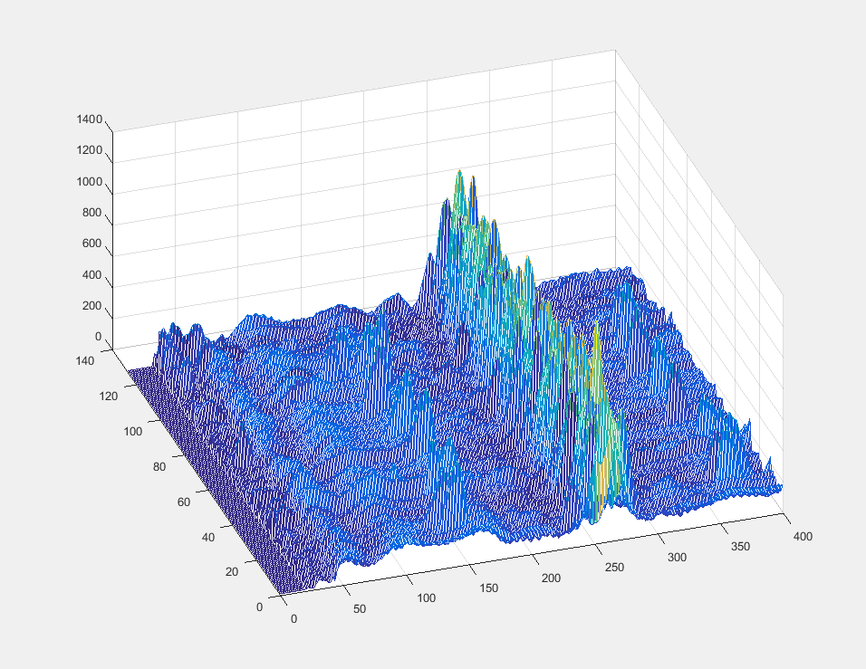
Looking at Figure 5, but in terms of this EKGs cepstral terrain
Figure 6
R-Rs
R-PVCs
P-Rs
R-Ts
Proprietary to Jadco Signals

Slide 8
Lagniappe with two more slides from previous examples

Slide 9
Given a set of EKG pulses. A-C show five pulses, a bunch of pulses, and a single pulse.
The x axis for A-C, and E, is sample number.
Pulses may seem equally spaced but they are not. A shows about 200 samples between pulses.
In D, the x-axis is pulse number and the y-axis shows the count of samples between pulses. Note the increases and
decreases in sample between pulses.
E expands on B by looking at the time series between pulses at 920 and 960 reveling an accordion-like action.
This is not new.
A
B
C
D
E

Slide 10
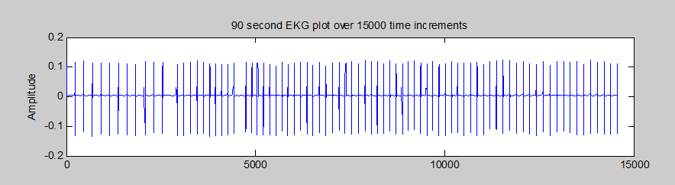
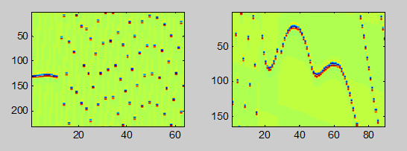
Here we frame the time series based on Cepstral components. For the series below,
two Cepstral coefficients stood out: 200 and 150. Similar to the HEADER/SCRAMBLER slide
Depending on how the time series is framed, the structure appears or disappears.
The accordion effect shown in E is pictured in the right side plot of G. This technique of
signal processing may be new to this type of data. Notice, we have taken a Fourier
Transform. Only now, in column form would it make sense to take a Fourier transform. Why,? An FT or DFT
needs a period. It is more than a technicality, it is a difference of 3dB in signal detection.
F
G

