Slide 1
Motivation of Cepstrum Using Voice
I was working on a project for the Air Force Research Lab’s Information Directorate. The project entailed characterizing the flow of (computer) network traffic. I was talking to this ‘Old Guy’, Mr. Jim Cupples. He worked in the Audio Department at the Lab. He saw what I was doing, and he said “you know….”
And I said, “uh huh…..Oh…Treat the computer like it is talking”.
Not only has that ‘little discussion’ turned into a device I call the Audio Visual IP Evaluator (The RueBea AVIPE Viewer in Chapter 7), for Network traffic, it has also evolved into a tool to look deeper into physical signals like the EKG (Chapter 5).
We start introducing the cepstrum by showing physical patterns in a voice.

Slide 2

I uttered…
do, re, mi, fa, so

Slide 3
do, re, mi, fa, so

Slide 4
This is a digital recording which means there are actual spaces
of no recording between the sounds you hear
Which we will show as we drill down,
and down
and down
and down

Slide 5
Let’s focus on ‘Do’

Slide 6
Zoom 1
You may see regular spikes

Slide 7

Zoom 2

Slide 8
Now change from time to sample number
Sometimes it is easier to interpret physical
events by counting sample points instead of lapsed time
This audio was recorded at 22,000 samples per second

Slide 9
If we take 22,000 samples of a waveform every 1 second
then
that’s the same as taking 2,200 samples every 1/10 second
So next we plot 2,200 points from the middle of ‘do’

Slide 10
For convenience in analysis we plot the 2200 points
starting at 1, after all, time is relative.

Slide 11
Now, the previous plot appears to be solid but actually there are
line segments connecting the samples
So we now work backwards a little to show the actual sampling with dots
And that the blue segments that connect the dots,
Really don’t exist
and that’s ok
Apparently, if not superficially, our mind doesn’t mind,
when we listen to a music CD,
or a cell phone
or the digitized audio of my ‘do re mi fa so’
or even a digitized EKG Heart Beat

Slide 12
Do with ‘dots’ to show actual points measured.
There is no need for continuity in my analysis, in fact, It is distracting.
There is more information than pointing to the repetition of waveform, we can point
to a count, and thus contrast this count against other counts.

Slide 13
A pattern of discrete, separated, numbers
You could count the dots between the peaks
Of the sub-wave blocks of ‘do’, or
You could invoke the cepstrum, which offers the number
236

Slide 14
The voice’s underlying guttural response, i.e., repetition of a base waveform
and in which the Cepstrum is key feature to Speaker ID

Slide 15
Matrix view of previous waveform framed by 236

Slide 16
BACK-UP

Slide 17
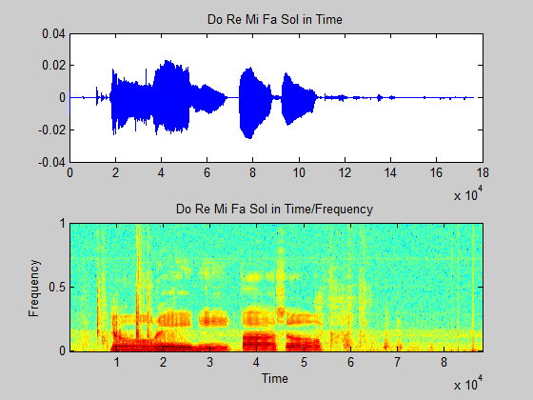
The usual voice recording and a SPECGRAM, which smears the frequency components

Slide 18
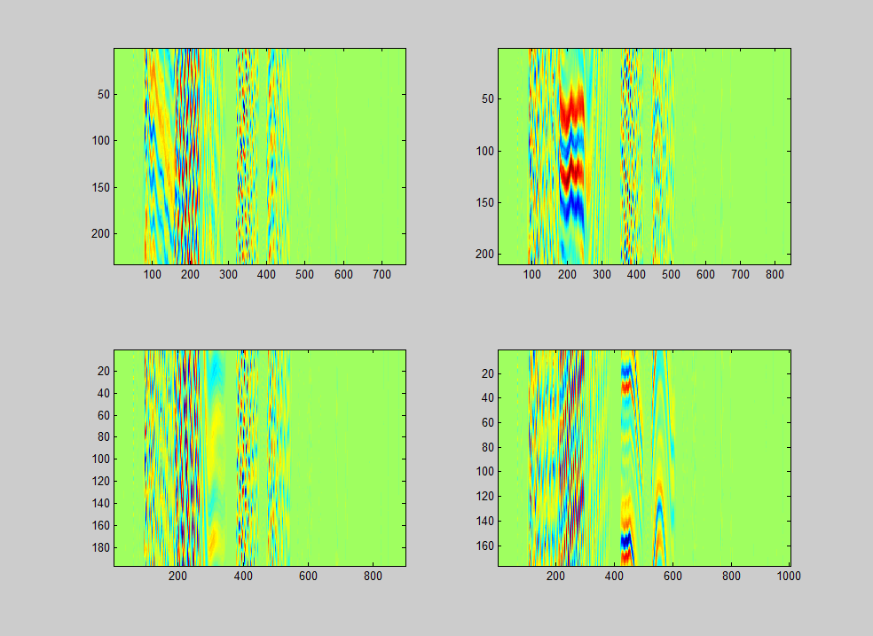
An unusual framing of ‘do-re-mi-fa-sol by appropriate Cepstral components.
The framing in B uses the RE cepstral coefficient.
Notice the intramodulation in the columns specific to RE.
Again, check out the link to Striatal Beat Frequency.
do re mi fa sol
do RE mi fa sol
232
209
A
B
do re MI fa sol
do re mi FA sol
C
D
196
176

